Slide 1
Canny Edge Detection Using an NVIDIA GPU and CUDA
Alex Wade
CAP6938 Final Project

Slide 2
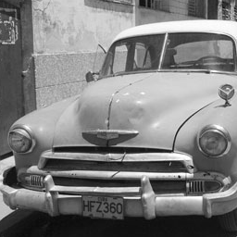
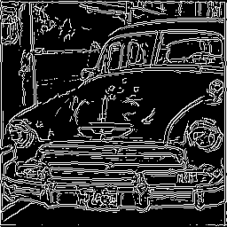
Introduction
GPU based implementation of A Computational Approach to Edge Detection by John Canny
Paper presents an accurate, localized edge detection method

Slide 3
Purpose
Canny’s edge detection algorithm involves a large number of matrix and floating point operations
Edge detection used as the first step for many computer vision tasks
Speeding up edge detection will increase computer vision performance, beneficial in cases such as live video feed processing

Slide 4
Algorithm Steps
Image smoothing
Gradient computation
Edge direction computation
Nonmaxmimum suppression
Hysteresis

Slide 5
Image Smoothing
Reduces image noise that can lead to erroneous output
Performed by convolution of the input image with a Gaussian filter
2 | 4 | 5 | 4 | 2
4 | 9 | 12 | 9 | 4
5 | 12 | 15 | 12 | 5
4 | 9 | 12 | 9 | 4
2 | 4 | 5 | 4 | 2
1
―
159
σ=1.4

Slide 6
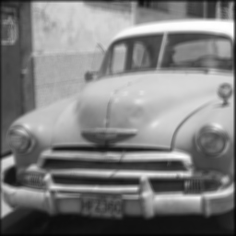
Image Smoothing

Slide 7
Gradient Computation
Determines intensity changes
High intensity changes indicate edges
Performed by convolution of smoothed image with masks to determine horizontal and vertical derivatives
-1 | 0 | 1
-2 | 0 | 2
-1 | 0 | 1
1 | 2 | 1
0 | 0 | 0
1 | 2 | 1
∇_{x}
∇_{y}

Slide 8
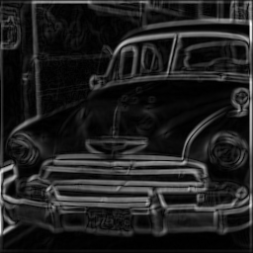
Gradient Computation
Gradient magnitude determined by adding X and Y gradient images
|∇|= |∇_{x}| + |∇_{y}|

Slide 9
Edge Direction Computation
Edge directions are determined from running a computation on the X and Y gradient images
Edge directions are then classified by their nearest 45° angle
∇_{x}
Θ_{x,y} = tan⁻¹ ⎯
∇_{y}

Slide 10
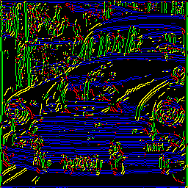
Edge Direction Computation
0 ° 90 °
45 ° 135 °

Slide 11
Nonmaximum Suppression
Used to localize edges
Uses edge direction classifications and gradient intensity values
For each pixel, determine whether its intensity value is higher than both of its perpendicular neighbors
All pixels that are not local maxima have their intensity values set to 0

Slide 12
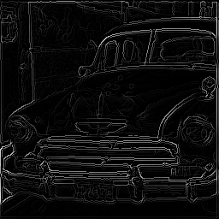
Nonmaximum Suppression

Slide 13
Hysteresis
Determines final edge pixels using a high and low threshold
Image is scanned for pixels with a gradient intensity higher than the high threshold
Pixels above the high threshold are added to the edge output
All of the neighbors of a newly added pixel are recursively scanned and added if they fall below the low threshold

Slide 14
Hysteresis

Slide 15
Implementation Status
Currently Implemented on GPU
Image Smoothing
Gradient Computation
To be Implemented (currently use CPU)
Edge Direction Computation
Nonmaximum Suppression
May be Implemented (currently use CPU)
Hysteresis
Will not be Implemented (done by CPU)
File I/O

Slide 16
GPU Implementation Details
Convolution kernels are sent to device global memory only once at initialization
Input and intermediate matrices are currently sent round trip from host to device texture memory for each step
Three round trips
Kernel functions use fixed 256x256 block size

Slide 17
Improvements to be Made
Implement edge direction computation and nonmaximal suppression
Improve GPU performance
Eliminate unnecessary round trips
Evaluate GPU memory use and correct as needed
Combine steps to reduce computation
Experiment further with block size
Try to implement hysteresis
General code optimization

Slide 18
Performance Evaluation
Host
Intel Core 2 Quad
2.66 GHz
3.25 MB RAM
Device
NVidia GeForce 8800 GT
512 MB Video Memory

Slide 19
Performance Evaluation
Verified correctness of CPU only and GPU based implementations
Collected performance metrics on 256x256, 412x512, 1024x1024, and 2048x2048 input images
Image smoothing time
Gradient computation time (including transfer to GPU and back)
Overall time excluding file I/O operations

Slide 20
Performance Results

Slide 21
Performance Results

Slide 22
Performance Results

